Slide 1

Food Ordering System In C
Name:Rahul Yadav
Collage:LNCTU
Enroll.No.:LN20MCA11016

Slide 2
Introduction
Purpose
Software Requirement
Hardware Requirement
Technology
Source Code
Output
Conclusion

Slide 3
Introduction
A food ordering system can be defined as software that allows restaurant businesses to accept and manage orders placed over the internet. ... First is a website or mobile app for hungry customers to view the restaurant's dishes and place an online order.

Slide 4
Purpose
With the improvement of technology, online food ordering systems are becoming a popular topic. That's because they are serving the ever increasing demand for convince. The main purpose of an online ordering system is to provide customers for a way to place an order at a restaurant over the internet.

Slide 5

Software Requirement
1. Dav c++ IDE.
2. Turbo c++ Compiler.
Select any one.

Slide 6
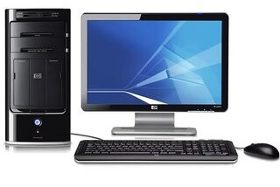
Hardware Requirement
Laptop/Desktop
Hard disk 1 gb.
RAM 512mb.

Slide 7
Technology
C programming language i used for this project . Functions are used many times in this project becouse of funtions makes readable code and easy to use.Switch i used for give the choice to the use .File handing used for save the user log in infromation .
This kind of technology i have used in this project .

Slide 8
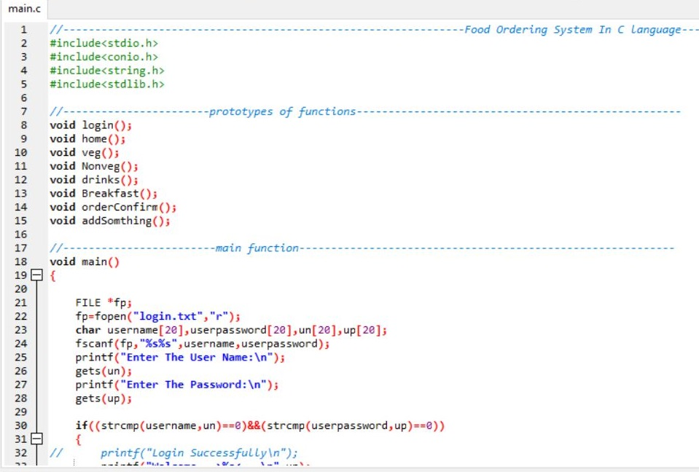
Source Code

Slide 9
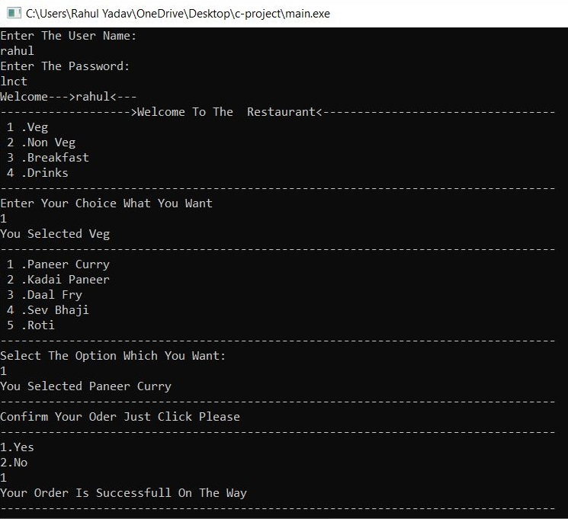
Output

Slide 10
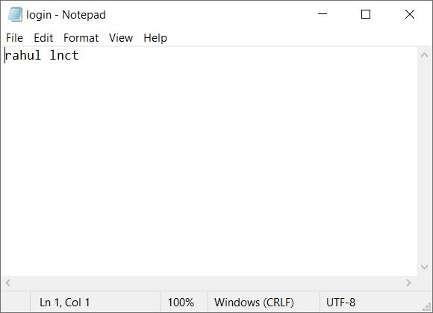
File Where We Store Log in Details

Slide 11
Concusion
The aim of the project was to build a responsive online application for restaurant which helps customers to order foods. Along with this, the application needs to be responsive as the application can be accessed through devices .

Slide 12
Thank You
Any Query?

